Slide 1
Insure Oklahoma ESI Income Guidelines (effective: 4/1/2026)
SIZE OF HOUSEHOLD | Minimum Monthly Income | Maximum Monthly Income | Maximum Annual Income
1 | $1,849 | $3,032 | $36,384
2 | $2,508 | $4,113 | $49,356
3 | $3,166 | $5,191 | $62,292
4 | $3,823 | $6,269 | $75,228
5 | $4,482 | $7,350 | $88,200
6 | $5,139 | $8,429 | $101,148
7 | $5,797 | $9,507 | $114.084
8 | $6,456 | $10,588 | $127,056

Slide 2
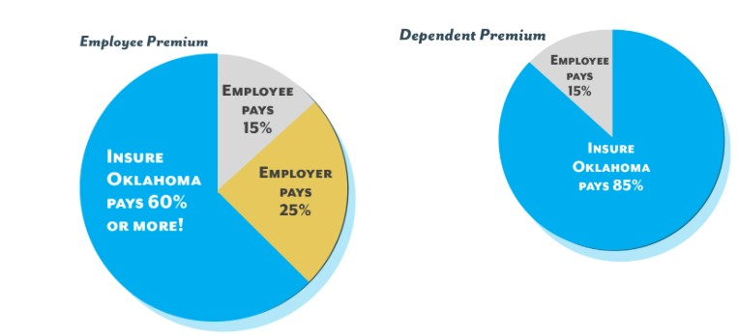
Insure Oklahoma Funding

Slide 3
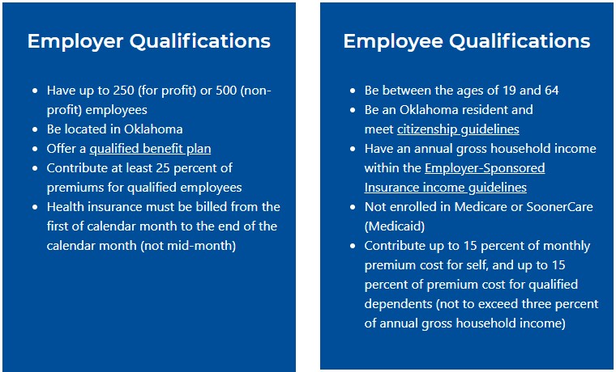
Insure Oklahoma Qualifications

Slide 4
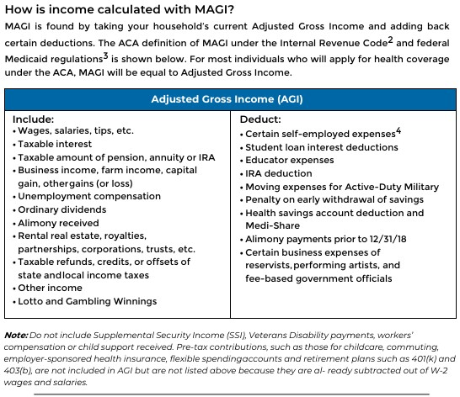
What is Income?

Slide 5

Adjusted Gross Income
Special Note: Household AGI will include the AGI of age 16+ children living in the home

Slide 6
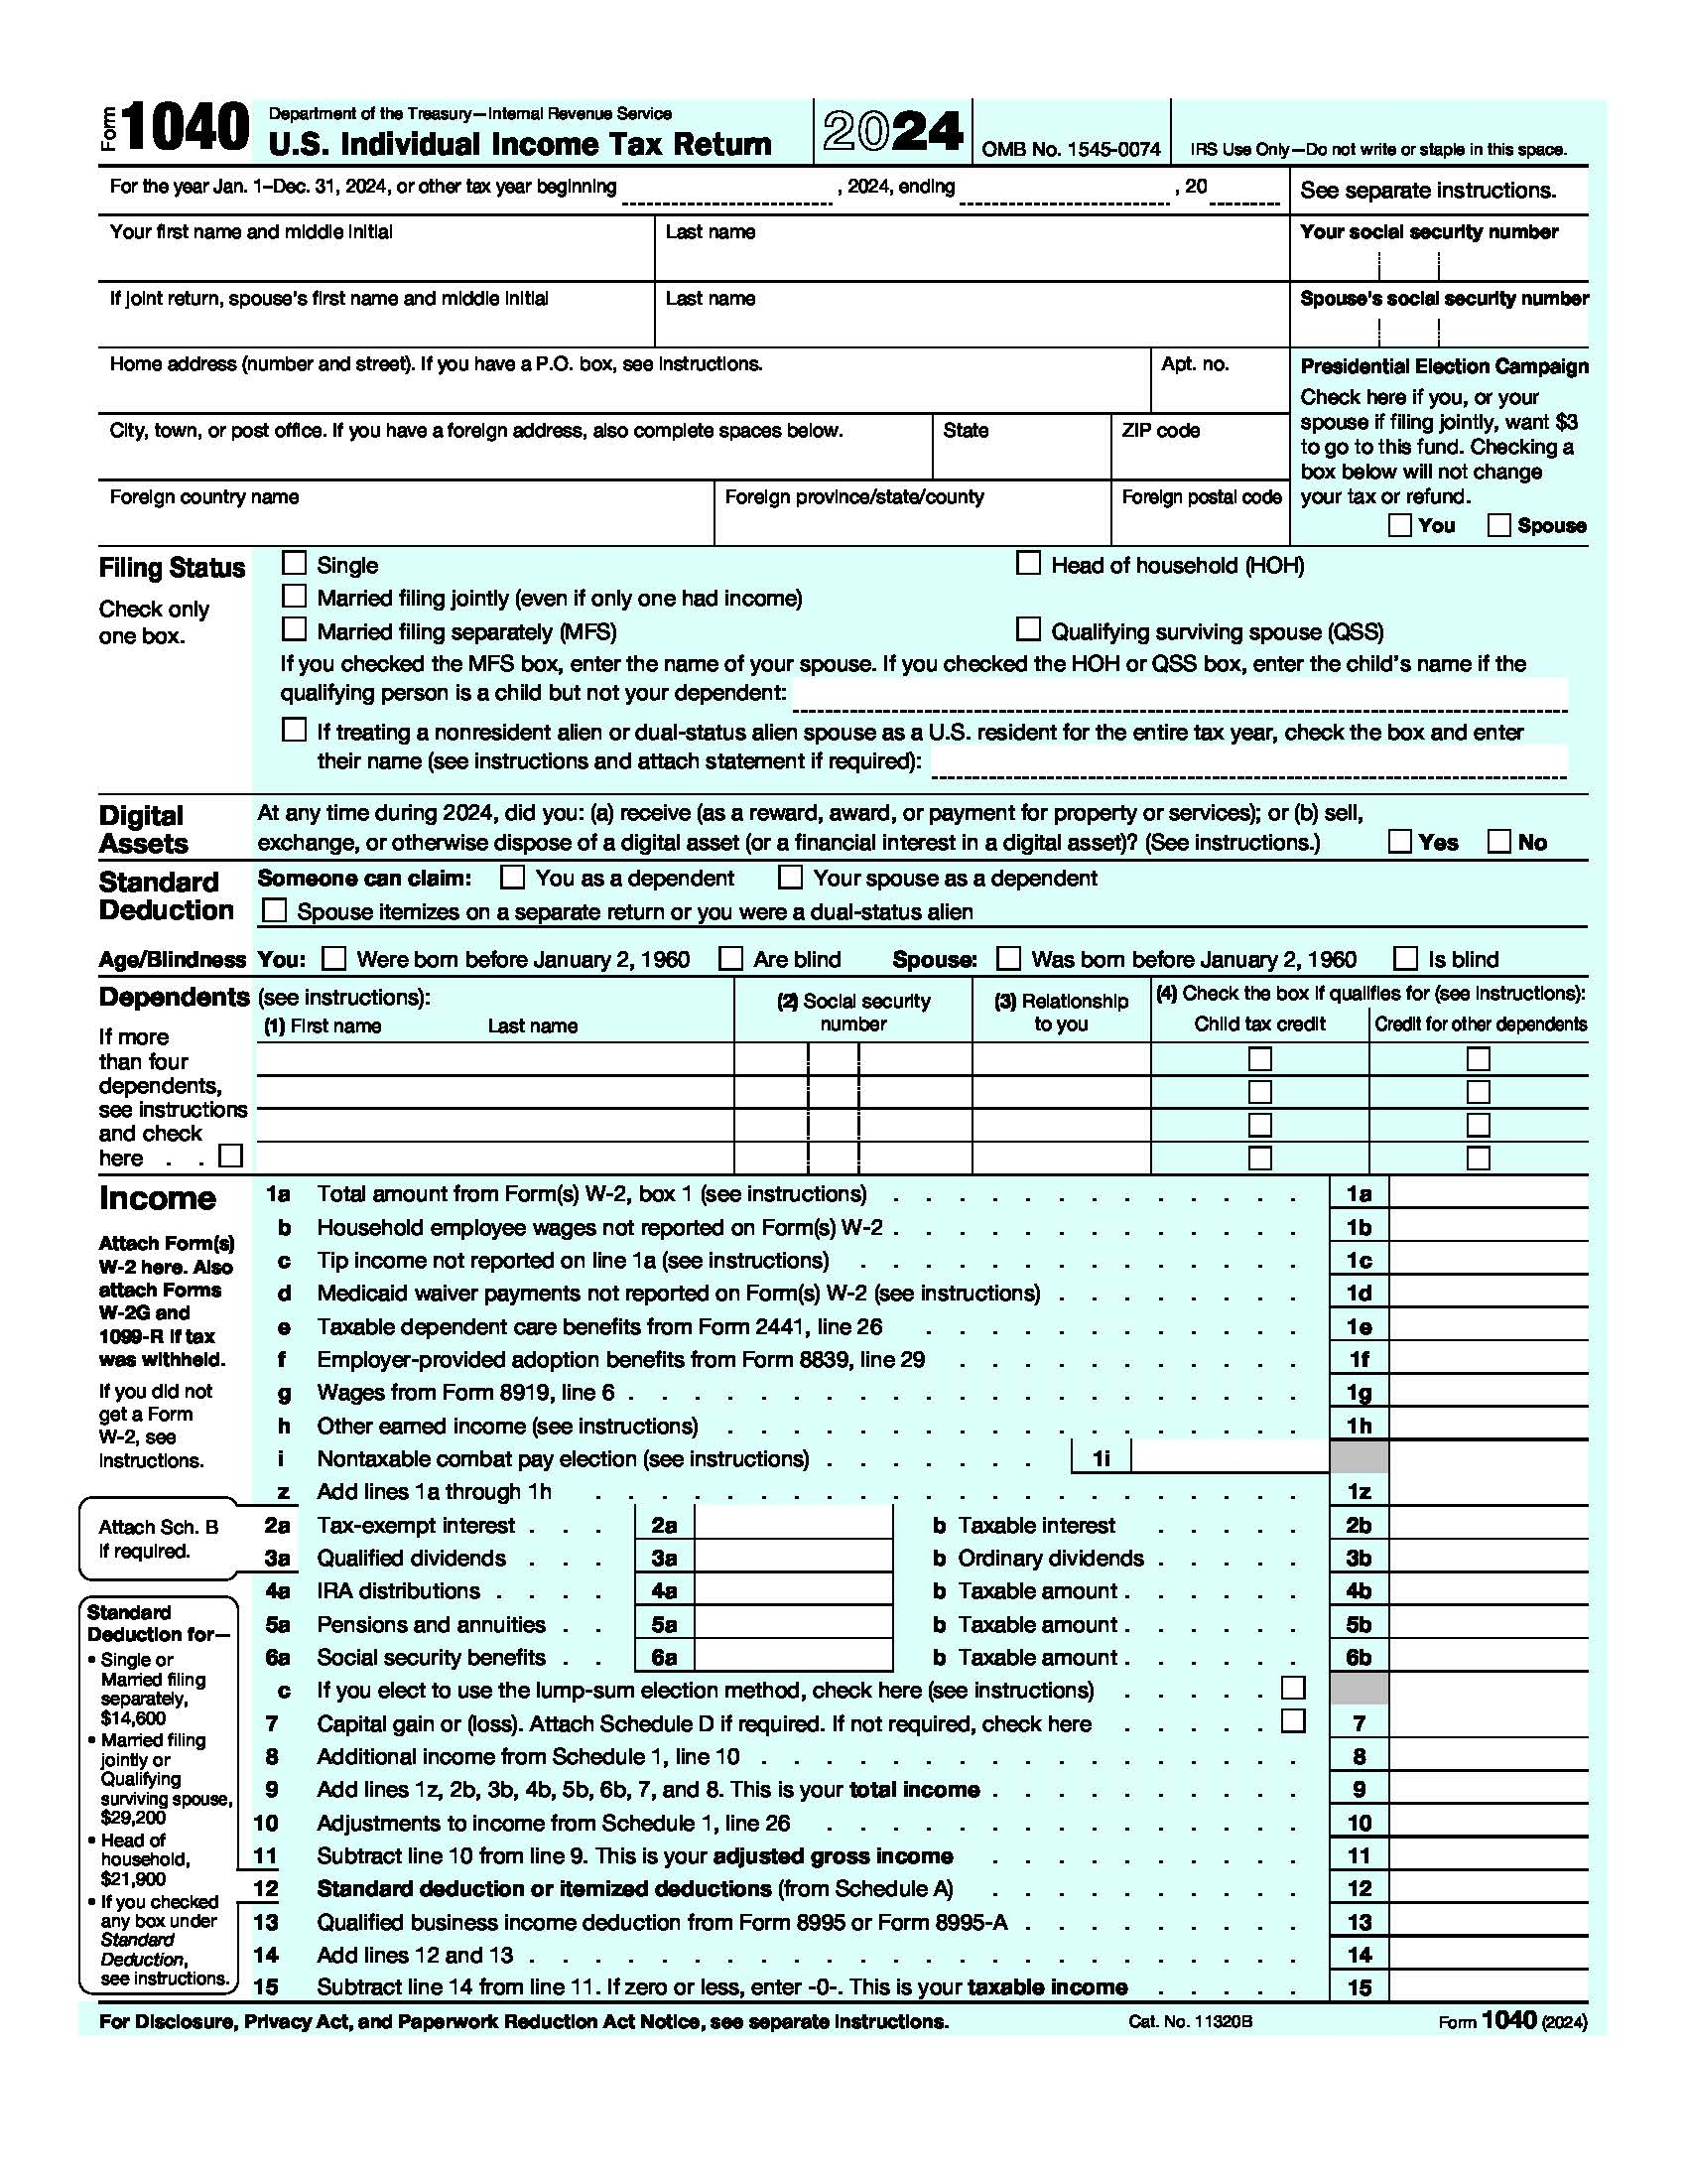

Slide 7
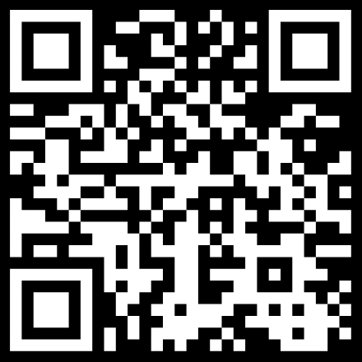
Insurance for Churches and Small Employers
https://oklahoma.gov/ohca/insureoklahoma/employers/plans.html
Groups as small as 1 –
Blue Cross Blue Shield
Aetna
United Healthcare
& More

