Slide 1

Mental health crisis
What to do when you witness a crisis?

Slide 2
If a person is an immediate life-threatening danger to themselves or to others, call 911.

Slide 3
Immediate:
Possession of weapon with extreme agitation, sadness, or despair
Active self-inflicted wound
Signs for overdose

Slide 4
If you are concerned that someone you know or love is considering ending their life, 988 can help.
Call or text any time to get connected with a local operator, who can connect your resources and guide you on how to safely help the situation.

Slide 5
https://988oklahoma.com/

Slide 6
If you are concerned that someone is considering ending their life, 988 can help.
Call or text any time to get connected with a local operator, who can connect your resources and guide you on how to safely help the situation.

Slide 7
TALK
Talking about wanting to die or to kill themselves
Researching ways to kill themselves, like searching online or buying a gun
Talking about feeling hopeless or having no reason to live
Talking about feeling trapped or being in unbearable pain
Talking about being a burden to others

Slide 8
BEHAVIOR
Increased use of alcohol or drugs
Acting anxious or agitated, or behaving recklessly
Sleeping too little or too much
Withdrawing or isolating themselves
Showing rage or talking about seeking revenge
Extreme mood swings

Slide 9
Environmental
Access to lethal means including firearms and drugs
Prolonged stress, such as harassment, bullying, relationship problems or unemployment
Stressful life events, like rejection, divorce, financial crisis, other life transitions or loss
Exposure to another person’s suicide, or to graphic or sensationalized accounts of suicide

Slide 10
Initial Response
*You hear them & appreciate them sharing
*Show your support (We are here for you. You don’t have to be alone.)
*Encourage them to keep sharing.
*Ask – how long have you felt this way, what has changed in your life
*Be direct, calm, and compassionate if you suspect self-harm = Are you thinking about killing yourself?

Slide 11
Initial Response Continued
“How often are you having these thoughts?”
"When it gets really bad, what do you do?"
“What scares you about these thoughts?”
“What do you need to do to feel safe?”

Slide 12
Initial Response Continued
“I hear you that you’re struggling, and I think it would really be helpful for you to talk to someone who can help you get through this.”
***Help them connect to counseling.

Slide 13
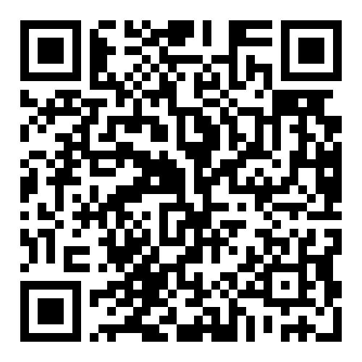
How to have the conversation:
https://talkawaythedark.afsp.org/thinkingaboutsuicide

Slide 14
Demonstrate Love and Compassion.
Stabilize the crisis.

